Slide 1
Capstone Project - 2
Rental Bike Demand Prediction

Slide 2
AGENDA
INTRODUCTION
PROBLEM STATEMENT
EDA
DATA PREPROCESSING
MACHINE LEARNING
SUMMARY

Slide 3
INTRODUCTION
The present scenario is about how good is the customer service in any industry as the number of options at the customer’s disposal are unlimited.
So, it becomes extremely important to make sure that the customers will not be made to wait for the rental bikes.
It would also not be practical to keep lot of bikes even when the demand is low. Hence , with the help of machine learning, this project aims at predicting the rental bike demand so that no problems arise.

Slide 4
PROBLEM STATEMENT
The project goal is to predict number of rental bikes required at a particular time of the day.

Slide 5
Data Description
DATA DESCRIPTION
Date : year-month-day
Rented Bike count - Count of bikes rented at each hour
Hour - Hour of the day
Temperature-Temperature in Celsius
Humidity - %
Wind speed - m/s
Visibility - 10m
Dew point temperature - Celsius
Solar radiation - MJ/m2
Rainfall - mm
Snowfall - cm
Seasons - Winter, Spring, Summer, Autumn
Holiday - Holiday/No holiday
Functional Day - NoFunc(Non Functional Hours), Fun(Functional hours)

Slide 6
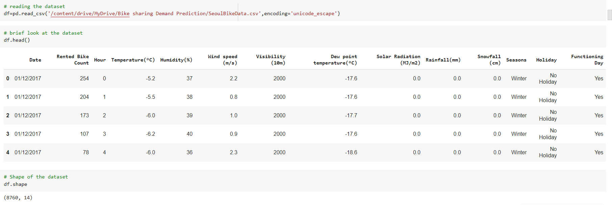
EDA

Slide 7
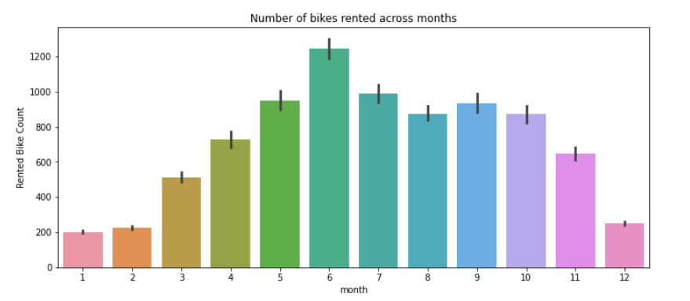
EDA
June has the highest rented bike count followed by July

Slide 8
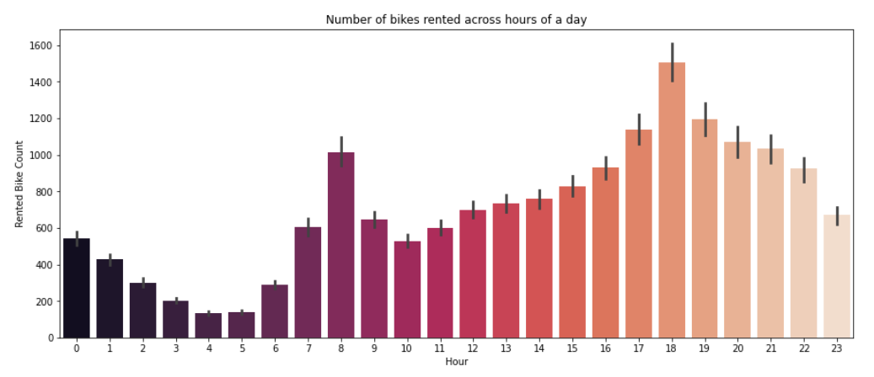
EDA
6pm is the time where most number of rental bikes are needed.

Slide 9
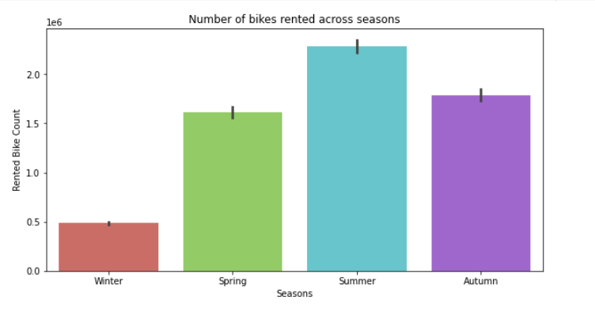
EDA
Summer season is when most bikes are rented.

Slide 10
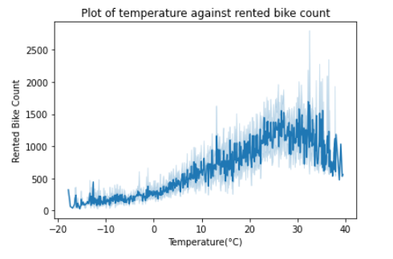
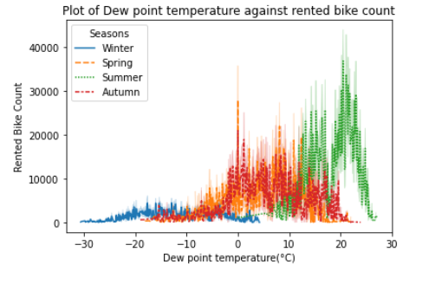
EDA
Most bikes are rented when the temperature exceeds 20𐩑.
Summer season is when most bikes are rented.

Slide 11
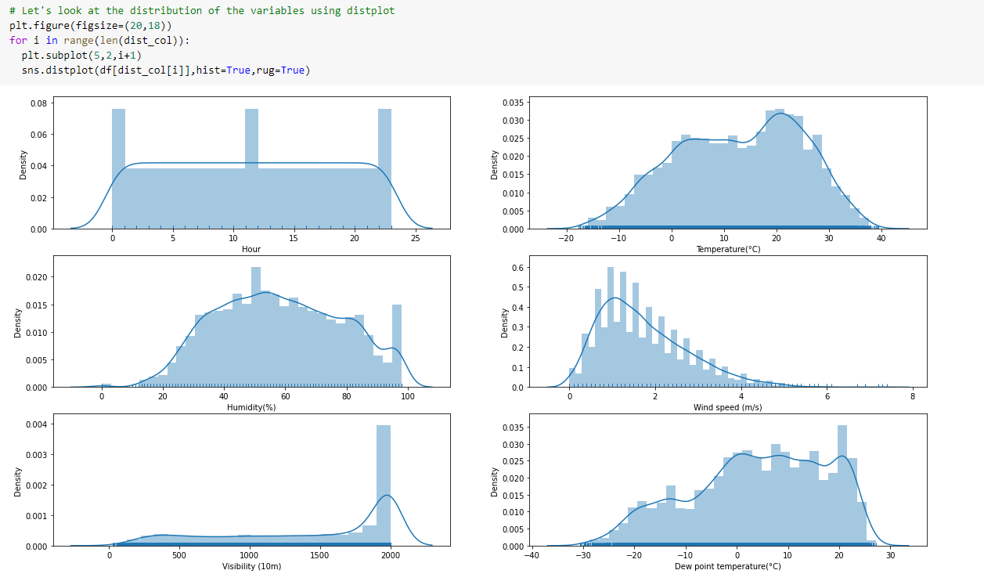
DISTRIBUTION PLOT

Slide 12
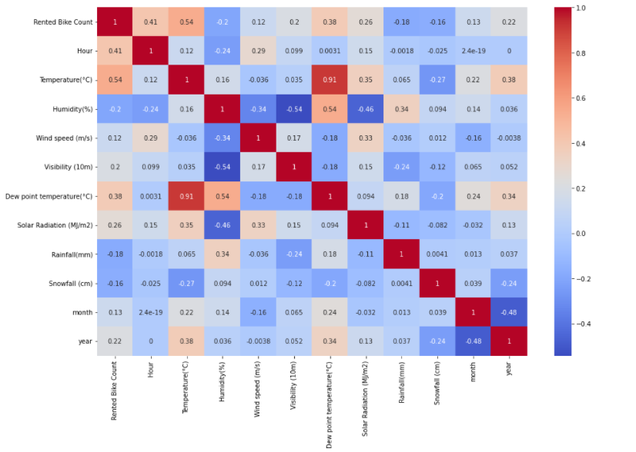
CORRELATION HEATMAP

Slide 13
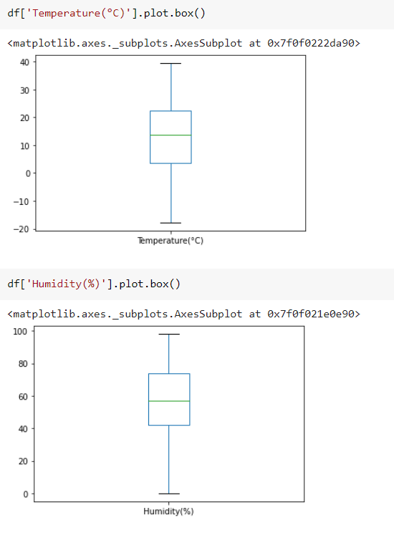
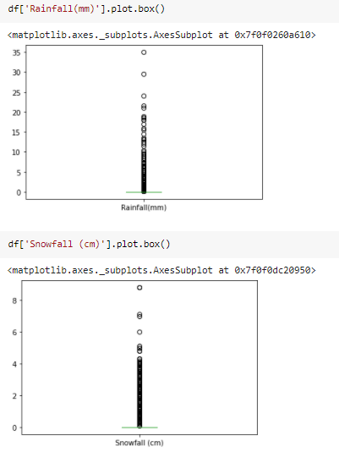
BOX PLOT

Slide 14
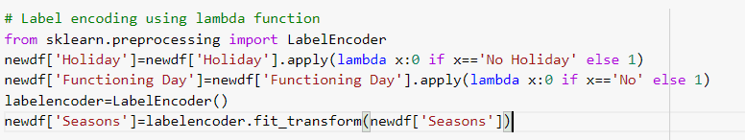
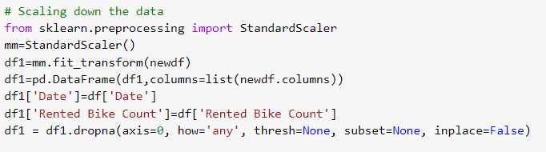
DATA PREPROCESSING

Slide 15
MACHINE LEARNING

Slide 16
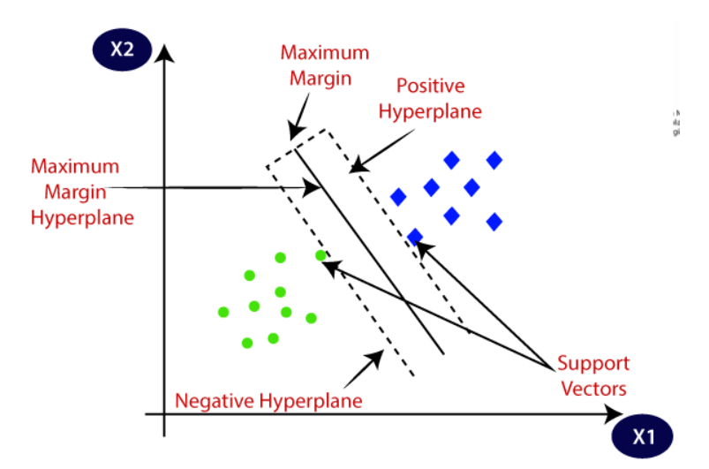
SUPPORT VECTOR MACHINE
Support Vector Machine or SVM is one of the most popular Supervised Learning algorithms, which is used for Classification as well as Regression problems.
The goal of the SVM algorithm is to create the best line or decision boundary that can segregate n-dimensional space into classes so that we can easily put the new data point in the correct category in the future. This best decision boundary is called a hyperplane.
SVM chooses the extreme points/vectors that help in creating the hyperplane. These extreme cases are called as support vectors, and hence algorithm is termed as Support Vector Machine.

Slide 17
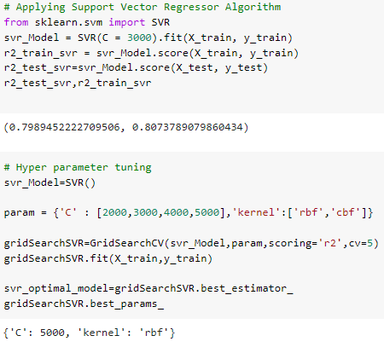
Train R2 score of optimal SVR model is 81.78 % Test R2 score of optimal SVR model is 81.24 %
SVM

Slide 18
KNEAREST NEIGHBORS
K-NN algorithm assumes the similarity between the new case/data and available cases and put the new case into the category that is most similar to the available categories.
K-NN algorithm stores all the available data and classifies a new data point based on the similarity. This means when new data appears then it can be easily classified into a well suite category by using K- NN algorithm.
K-NN algorithm can be used for Regression as well as for Classification .
K-NN is a non-parametric algorithm, which means it does not make any assumption on underlying data.

Slide 19
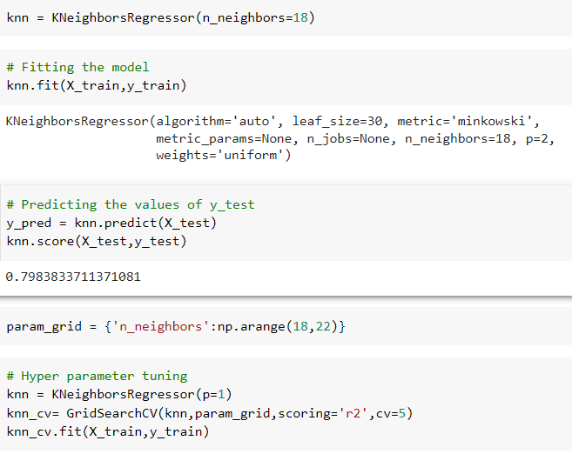
KNEAREST NEIGHBORS
Train R2 score of optimal knn model is 83.7 %
Test R2 score of optimal knn model is 80.61 %

Slide 20
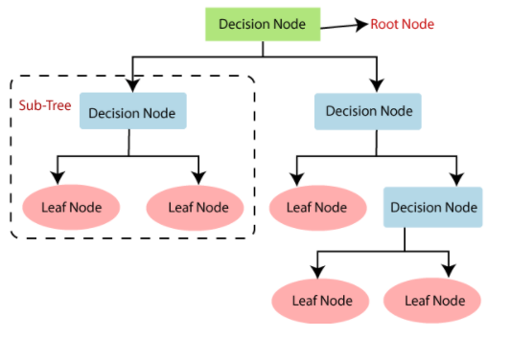
DECISION TREES
Decision Tree is a Supervised learning technique that can be used for both classification and Regression problems. It is a tree-structured classifier, where internal nodes represent the features of a dataset, branches represent the decision rules and each leaf node represents the outcome.
In a Decision tree, there are two nodes, which are the Decision node and Leaf node. Decision nodes are used to make any decision and have multiple branches, whereas Leaf nodes are the output of those decisions and do not contain any further branches.
The decisions or the test are performed on the basis of features of the given dataset.

Slide 21
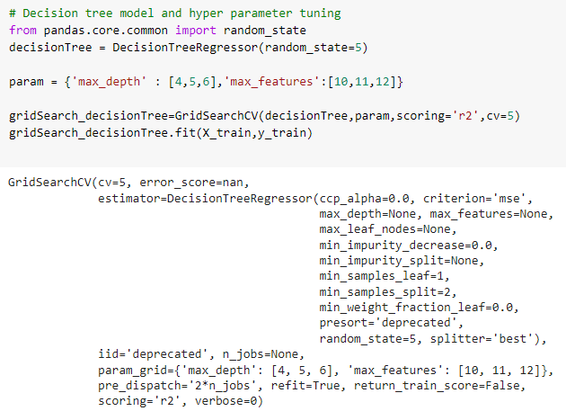
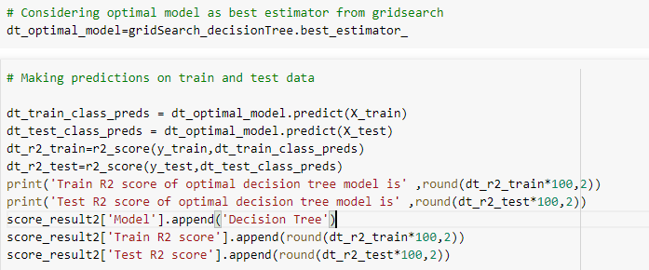
DECISION TREES
Train R2 score of optimal Decision tree model is 80.9 %
Test R2 score of optimal Decision tree model is 77.5 %

Slide 22
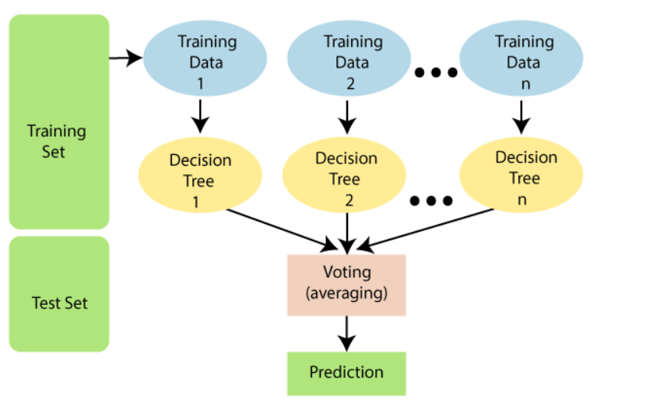
RANDOM FOREST REGRESSOR
Random Forest is a popular machine learning algorithm that belongs to the supervised learning technique. It can be used for both Classification and Regression problems in ML. It is based on the concept of ensemble learning, which is a process of combining multiple classifiers to solve a complex problem and to improve the performance of the model.
As the name suggests, "Random Forest is an algorithm that contains a number of decision trees on various subsets of the given dataset and takes the average to improve the predictive accuracy of that dataset." Instead of relying on one decision tree, the random forest takes the prediction from each tree and based on the majority votes of predictions, and it predicts the final output.

Slide 23
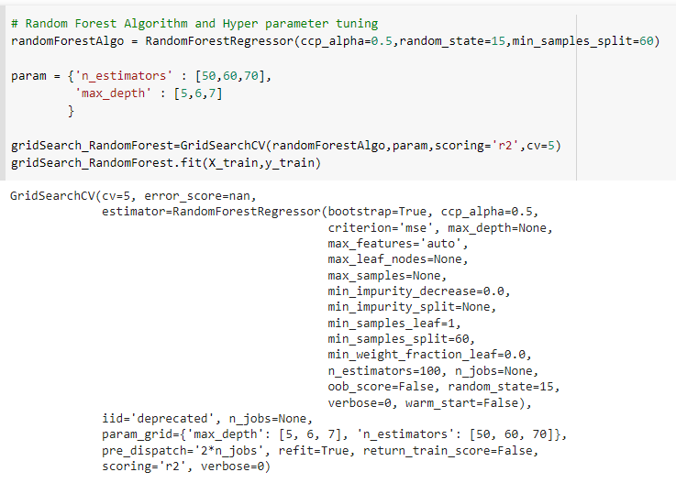
RANDOM FOREST REGRESSOR
Train R2 score of optimal Random forest model is 83.9 %
Test R2 score of optimal Random forest model is 82.23 %

Slide 24
XGBoost is an ensemble learning method. Sometimes, it may not be sufficient to rely upon the results of just one machine learning model. Ensemble learning offers a systematic solution to combine the predictive power of multiple learners. The resultant is a single model which gives the aggregated output from several models. XGBoost is one of the fastest implementations of gradient boosting trees. It does this by tackling one of the major inefficiencies of gradient boosted trees: considering the potential loss for all possible splits to create a new branch (especially if you consider the case where there are thousands of features, and therefore thousands of possible splits). XGBoost tackles this inefficiency by looking at the distribution of features across all data points in a leaf and using this information to reduce the search space of possible feature splits.
XGBOOST

Slide 25
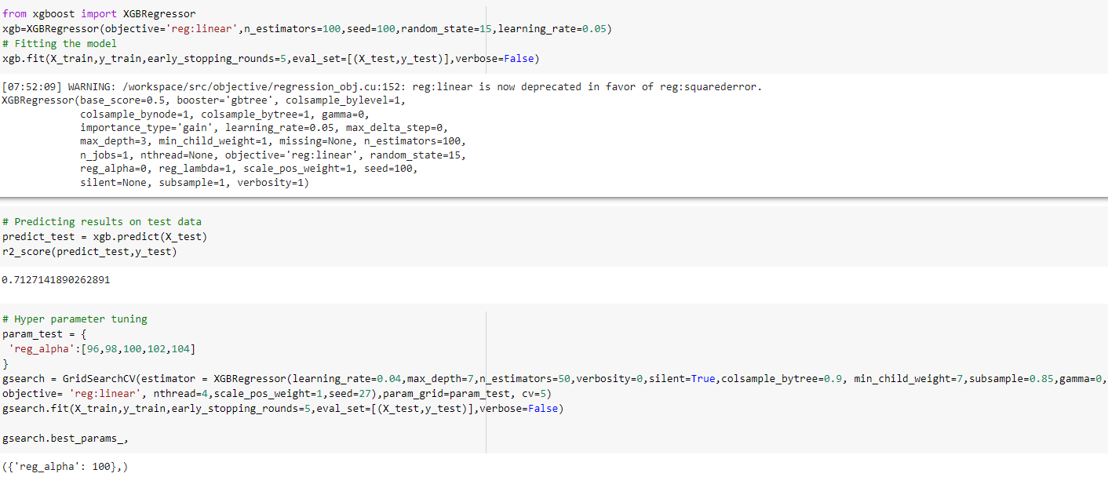
XGBOOST
Train R2 score of optimal XGBoost model is 84.3 %
Test R2 score of optimal XGBoost model is 81.64 %

Slide 26
SUMMARY
1. Performed Exploratory Data Analysis on the data to gain some insights.
2.Treated the outliers using log transformation.
3. Label encoding was done for categorical variables.
4.Standard Scaler was used to scale down the data.
5.Applied 5 machine learning models on the dataset i.e,
- Support Vector Machine.
- K Nearest Neighbor.
- Decision Tree.
- Random Forest Classifier.
- XGBoost.
6.Hyperparameter tuning was performed on all the models using Grid Search CV to get best parameters and best scores.
7.Random Forest Model performed best among the five models with train R2 score of 83.9 % and test R2 score of 82.23 %.

Slide 27
THANK YOU

